Slide 1
Employee Data Analysis using Excel
STUDENT NAME: Sharmila.P
REGISTER NO:122204048
DEPARTMENT:B.Com ( corporate secretaryship )
COLLEGE. Shri Krishnaswamy college for women

Slide 2
PROJECT TITLE
Employee gender Analysis using Excel

Slide 3


AGENDA
Problem Statement
Project Overview
End Users
Our Solution and Proposition
Dataset Description
Modelling Approach
Results and Discussion
Conclusion
3/21/2024 Annual Review

Slide 4

PROBLEM STATEMENT
- Calculate the percentage of male and female employees in each department, job role, and level - Identify departments, job roles, and levels with significant gender imbalances - Visualize the gender distribution using charts and graphs - Provide insights and recommendations for improving gender diversity and inclusion in the organization”

Slide 5

PROJECT OVERVIEW
- Analyze employee data in Excel to identify gender trends and patterns - Calculate gender ratios and percentages by department, job role, and level - Identify areas with significant gender imbalances - Visualize findings using charts, graphs, and tables - Provide insights and recommendations for improving gender diversity and inclusion

Slide 6

WHO ARE THE END USERS?
The end users of an employee gender analysis using Excel can be: 1. *HR Department*: To identify areas for improving gender diversity and inclusion, and to inform HR strategies and initiatives. 2. *Management Team*: To understand gender dynamics within the organization and make informed decisions about talent development, succession planning, and diversity initiatives. 3. *Diversity and Inclusion Committee*: To track progress towards diversity goals and identify areas for improvement. 4. *Employee Resource Groups*: To understand gender dynamics and advocate for gender-related initiatives.

Slide 7

OUR SOLUTION AND ITS VALUE PROPOSITION
- A comprehensive Excel-based analysis of employee gender distribution across departments, job roles, and levels - Customizable dashboards and visualizations to facilitate easy understanding of gender trends and patterns - Identification of areas with significant gender imbalances and recommendations for improvement - Ongoing tracking and monitoring of gender diversity metrics to measure progress over time

Slide 8
Dataset Description
The dataset should be anonymized to protect employee privacy. The distribution may vary based on the organization’s specific demographics and structure. Additional columns can be added to the dataset as needed (e.g. age, tenure, location, etc.). This dataset distribution provides a starting point for analyzing employee gender trends and patterns, and can be used to identify areas for improvement and track progress over time.

Slide 9

THE "WOW" IN OUR SOLUTION
1. *Interactive Dashboards*: Create interactive and dynamic dashboards that allow users to explore and visualize gender trends and patterns in real-time. 2. *Automated Analysis*: Develop automated analysis tools that identify areas with significant gender imbalances and provide recommendations for improvement.
3/21/2024 Annual Review
9

Slide 10
MODELLING
1. *Data Preparation*: - Import employee data into Excel - Clean and preprocess data (e.g., handle missing values, data formatting) 2. *Gender Distribution Analysis*: - Calculate gender ratios and percentages by department, job role, and level - Use pivot tables and charts to visualize gender distribution 3. *Gender Gap Analysis*: - Calculate gender gaps in hiring, promotion, and termination rates - Use conditional formatting to highlight significant gender gaps 4. *Regression Analysis*: - Perform linear regression to identify factors influencing gender diversity (e.g., department, job role, level) - Use coefficients and p-values to interpret results
10

Slide 11
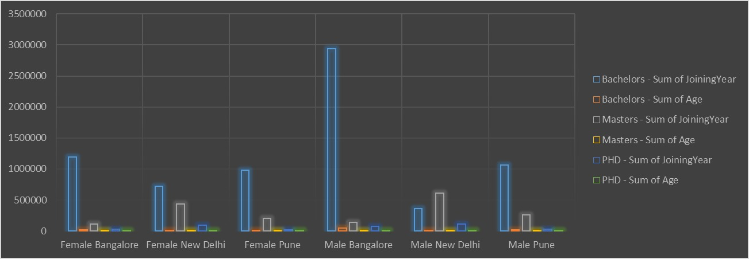
RESULTS
11

Slide 12
conclusion
The employee gender analysis using Excel has provided valuable insights into the gender distribution and trends within our organization.

